Slide 1
Improving benefit uptake Peter Beckett Project Co-Ordinator Welfare Reform Mitigation

Slide 2
WHY & WHY CAB
Why?
Social Security is a human right
The Scottish Government is committed to ensuring that people in Scotland take up all of the support they are entitled to
Why CAB?
During 2016-17 Citizens Advice Bureaux supported almost 275,000 clients across Scotland
Frontline advice available at almost 300 service points
Holistic service
2

Slide 3
WHAT
Scottish Government Campaign –
“You’ve Earned it. Why Not Claim it?”
3
Radio and local press campaign
September October November December
25th
2nd
9th
6th
1st
Public Advice Line – manned by advisers from Citizens Advice Edinburgh
Citizens Advice Bureau

Slide 4
WHAT
Scottish Government Campaign –
“You’ve Earned it. Why Not Claim it?”
4
Radio and local press campaign
Bus and TV campaign
September October November December
25th
2nd
9th
6th
1st
All CAB – taking enquiries
Helpline – manned by CAS and directing to nearest CAB
Public Advice Line – manned by advisers from Citizens Advice Edinburgh
Citizens Advice Bureau

Slide 5
KEY CAMPAIGN MESSAGES
Social security is an investment in everyone and is there to help people when they need it
Find out if you’re eligible for the support that you’re entitled to
It is estimated that more than half a million (500,000) individuals and families in Scotland are not claiming the benefits they are entitled to
Changes in life circumstances and life events mean anybody could need support at some point in their lives
Citizens Advice Scotland can provide further information, visit www.cas.org.uk/bureaux or call [the helpline]
5

Slide 6
CAMPAIGN
6
Four core executions were developed after extensive research, interviews and group discussions
Used in national press and on bus panels.
Important to portray those aged 65+ as active, valued members of society with a lot to give to their communities

Slide 7
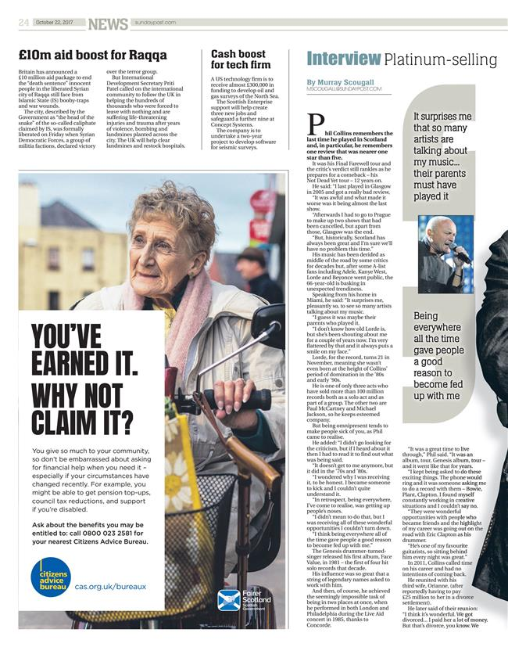
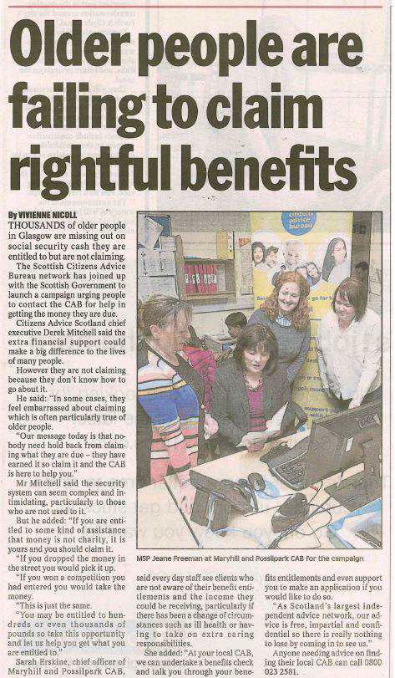
CAMPAIGN
7

Slide 8
WHAT
Scottish Government Campaign –
“You’ve Earned it. Why Not Claim it?”
8
Radio and local press campaign
Bus and TV campaign
September October November December
25th
2nd
9th
6th
1st
All CAB – taking enquiries
Helpline – manned by CAS and directing to nearest CAB
Public Advice Line – manned by advisers from Citizens Advice Edinburgh
Citizens Advice Bureau

Slide 9
WHAT
Scottish Government Campaign –
“You’ve Earned it. Why Not Claim it?”
9
Radio and local press campaign
Bus and TV campaign
September October November December
25th
2nd
9th
6th
1st
All CAB – taking enquiries
Helpline – manned by CAS and directing to nearest CAB
14 bureaux – undertaking Older People Financial Health Checks
Public Advice Line – manned by advisers from Citizens Advice Edinburgh
Citizens Advice Bureau

Slide 10
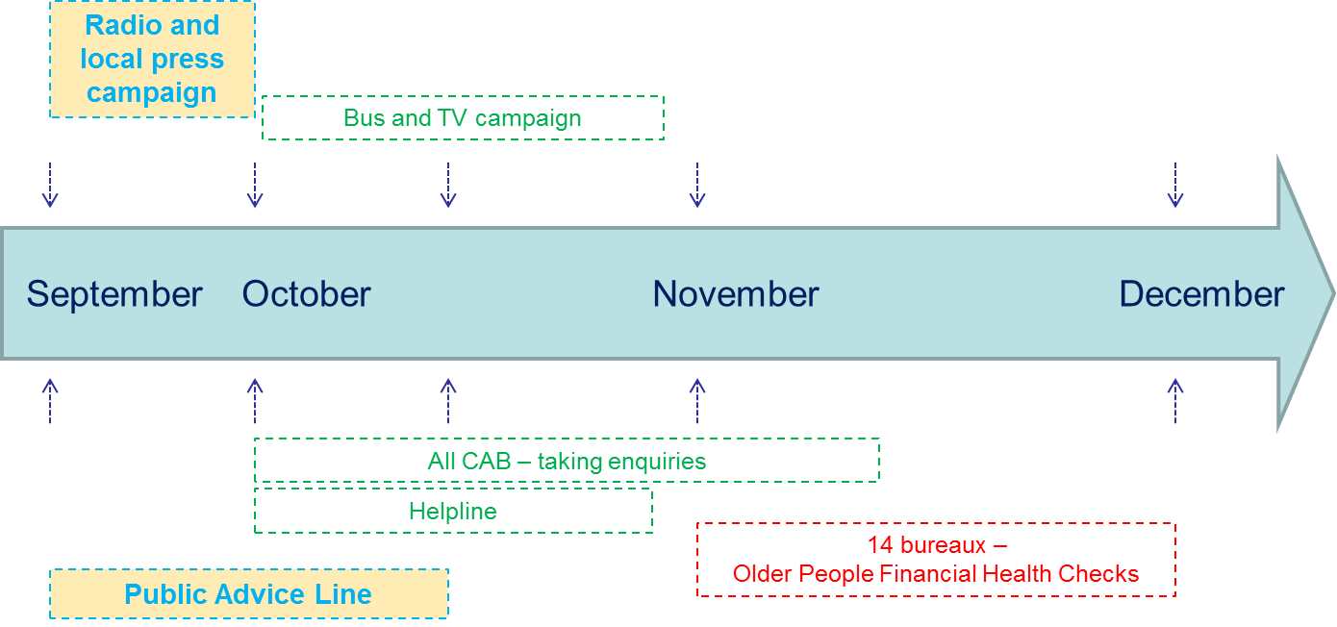
RADIO AND LOCAL PRESS
10
LESSONS LEARNED
Majority of clients interested in older people’s and disability related benefits
Newspaper ads by far the most effective media
Only 1.5% of callers also mentioned social media
Not as successful as a previous campaign in March 2017
OUTCOMES
140 calls over 2 weeks
245 issues
87% related to welfare benefits
55% of callers referred to local CAB for full benefits check

Slide 11
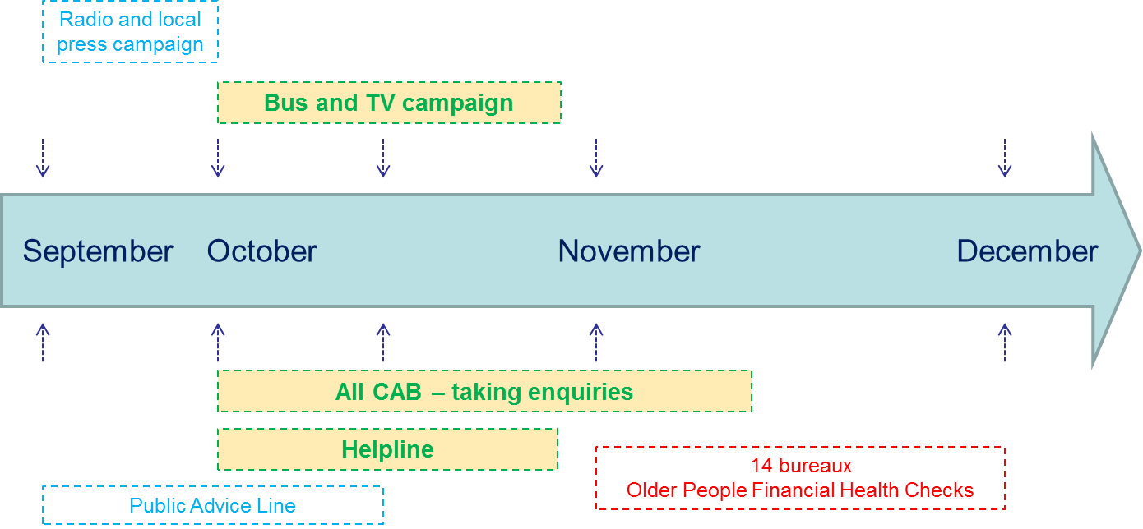
BUS AND TV
LESSONS LEARNED
Impact of previous Newspaper ads was retained, along with the impact of the TV ads
Need for advice on other issues were also supported by CAB
Clients needs and preferences are incredibly varied
11
OUTCOMES
463 calls over 4 weeks
5%age point increase in those who believed entitled to more benefits
Local CAB conducted 340 older people’s benefit checks
82% related to welfare benefits

Slide 12
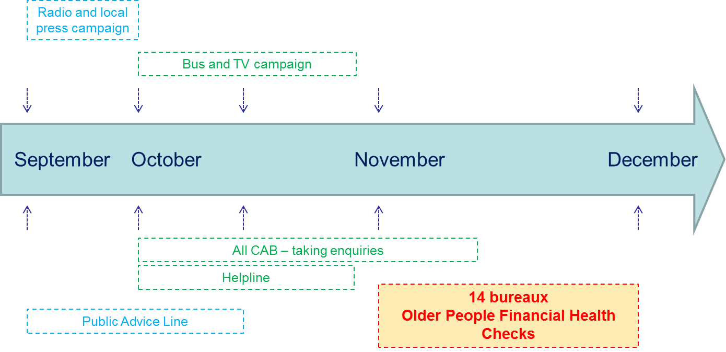
OLDER PEOPLES FINANCIAL HEALTH
LESSONS LEARNED
82% of clients were aged 60+
Newspaper and TV advertisements through October were seen as effective
Most successful bureaux actively contacted previous clients
68% of clients had no access to the internet
12
OUTCOMES
14 bureaux participated over 4 weeks
436 clients were seen with 691 issues
58% were welfare benefit issues
Direct client financial gain of over £153,000 (across all three elements)

Slide 13
OLDER PEOPLES FINANCIAL HEALTH
OTHER OBSERVATIONS
Those clients that participated had little reticence in claiming what they were entitled
However, remoter communities had greater difficulty engaging older people
Successful engagement was resource intensive
Linking in with other local partners has even greater potential
13

Slide 14
CONCLUSIONS FROM CAMPAIGN
14
Campaign successful in driving action – calls to helpline, visits to website, financial gain
TV drives recognition. Press helps drive calls. Overlap is vital to campaign success.
Positive movement in attitudinal change, but more work to be done. Long-term approach needed.

Slide 15
BROADER CONCLUSIONS
Scottish Government and CAB can work together to deliver successful outcomes for disadvantaged groups
Importance of income maximisation through financial health checks
Longer term impact?
New approaches can deliver - so long as the resource and funding is provided
15

